Slide 1
Tiered
Huddles

Slide 2
Introduction to Tiered Huddles
Tiered Huddles are daily meetings that occur across multiple levels (tiers) of leadership within an organization.
Team Huddles occur within each tier to:
Check the status of work
Identify problems
Take countermeasures such as escalation
Ensure that issues are addressed

Slide 3
Structure of Tiered Huddles
Representatives from each tier attend the team huddle of their adjacent tier to support accurate communication of information and appropriate escalation between tiers.

Slide 4
Tool components for Tiered Huddles
Tiered Team Huddles
Huddle Boards
Huddle Reports
Huddle Action Items

Slide 5
Tiered Team Huddles

Slide 6
What are Tiered Team Huddles?
Tiered Team Huddles are brief and regimented conversations between team members within tiers that focus on the impediments of safe patient care and addressing them in a timely, efficient manner.
People from adjacent tiers attend the meetings to be able to escalate issues and communicate important information to tiers above and below.

Slide 7
Why implement Tiered Team Huddles?
Competing priorities, staffing changes, and patient safety issues require immediate attention.
Hospital leaders may not be able to respond to these demands when they are not communicated by hospital staff.
Tiered Team Huddles offer hospitals a streamlined process for escalating issues while also ensuring that the right person in the organization can address the issue.

Slide 8
Tiered Team Huddles overview
Team huddles should:
  Take place at the start of each shift
  Include a formal review of key metrics, problems, and action items
Huddles should also:
  Provide staff members an opportunity to discuss incoming patients
  Anticipate the needs or concerns of patients and team members

Slide 9
Designing Tiered Team Huddles: Huddle leader
A Tiered Team Huddle leader will be responsible for leading the team huddle and making sure all team members feel involved and will be tasked with:
Huddle time: Choosing a time to hold daily Tiered Team Huddles based on team members’ availability and the meeting times of the other tiers (e.g., Tier 1 Team Huddles must occur before Tier 2 Team Huddles)
Huddle location: Reserving a location to hold Tiered Team Huddles

Slide 10

Designing Tiered Team Huddles: Huddle leader, continued
Communication: Communicating action items and recommendations to tiers above and below
Resource management: Proposing a list of team member roles (e.g., notetaker) and responsibilities to keep Tiered Team Huddles on task

Slide 11
Designing Tiered Team Huddles: Huddle objectives
Identify the specific topics that will be discussed during the huddle. Some of the major topics for frontline staff may include:
  Current and anticipated staffing needs
  Bed occupancy
  Number of HAIs or standardized HAI rate

Slide 12
Designing Tiered Team Huddles: Creating a huddle
Establish meeting rules: Lay out ground rules for participating in Tiered Team Huddles and make team members feel that their opinions matter.
Establish etiquette: Establish ground rules and specify when team members can vocalize their concerns.
Plan for conflict resolution: Individuals should understand who they should turn to in order to resolve conflicts.

Slide 13

Designing Tiered Team Huddles: Creating a huddle, continued
Make time for follow-up: Make time during the huddle to close the loop on previous issues that still need to be resolved.
Celebrate accomplishments: Celebrate small wins when one or more team members go above and beyond to prevent an HAI.

Slide 14
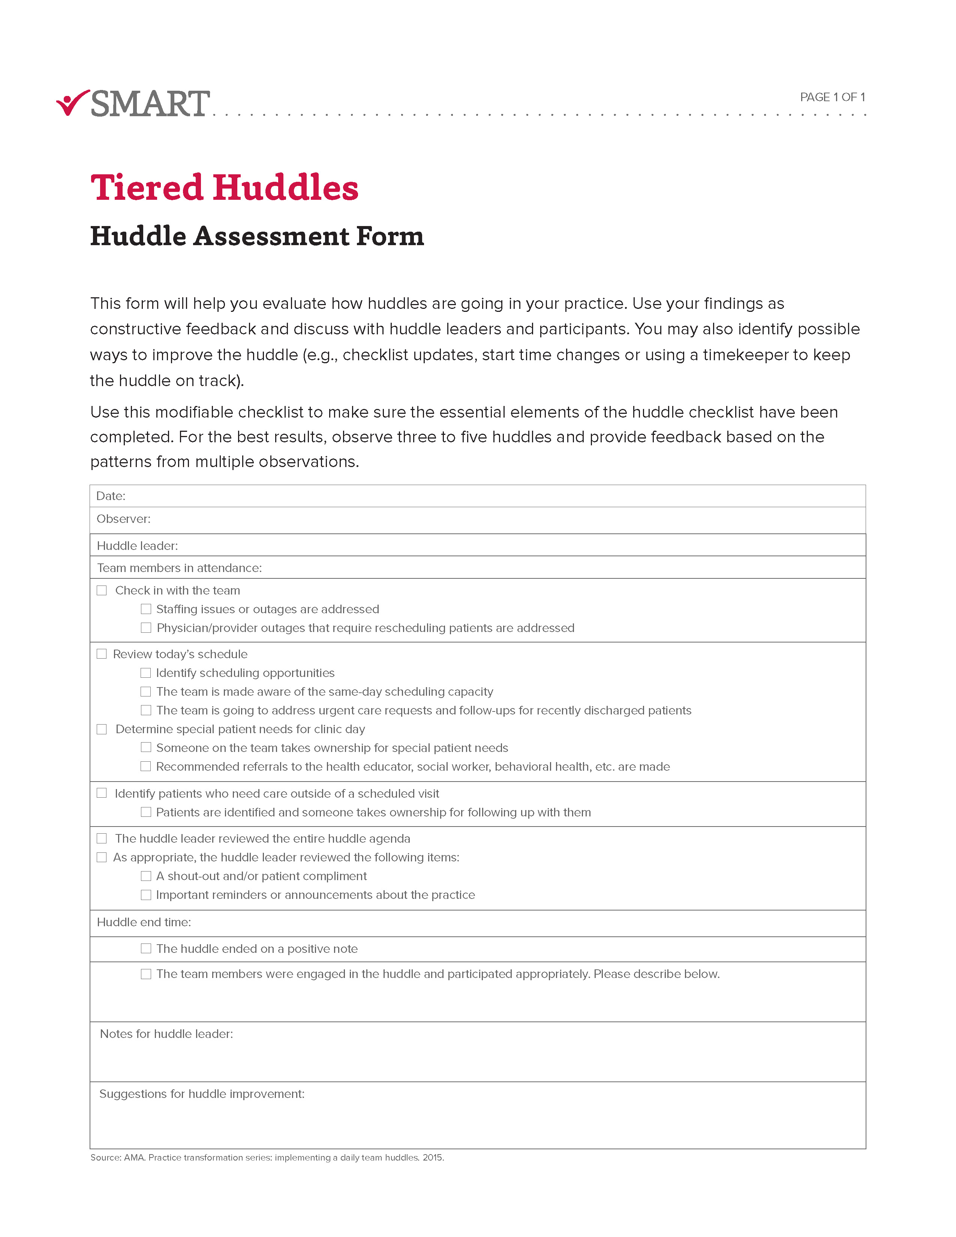
Huddle Assessment Form
Use this form to observe multiple team huddles
in order to provide feedback and to identify opportunities to make the huddle process more efficient.

Slide 15
Tiered Team Huddles Case Study
Read the Tiered Team Huddle case study and discuss with your team members how you would answer the questions found in the activity.
Use this activity as an opportunity to engage team members in a dialogue about ways to improve huddle processes.

Slide 16

Tiered Team Huddles implementation considerations
Consider the following strategies to ensure Tiered Team Huddles are implemented effectively:
  Have a communication plan
  Provide incentives
  Test processes
  Establish a schedule

Slide 17
Tiered Team Huddles: Best practices
Maintain a regular schedule
Use Huddles as an improvement activity, not just to report issues out
Align Huddle objectives with broader organizational goals and priorities
Keep track of Huddle attendees and invite individuals to your Huddle who can facilitate change

Slide 18
Huddle Boards

Slide 19
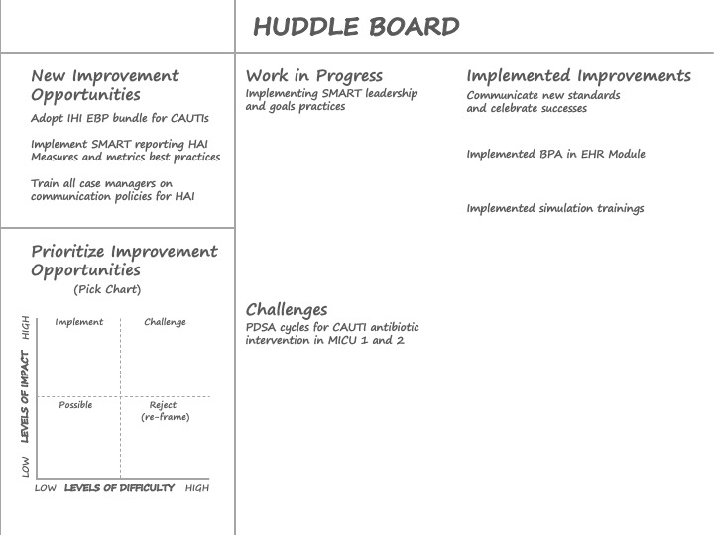
What is a Huddle Board?
Huddle boards are used to document standard metrics:
Report and compare performance on organizational targets for HAI prevention
Tailor to the needs and objectives of each Tiered Huddle team

Slide 20
Why use a Huddle Board?
Provide structure and organization: Without structure, Tiered Team Huddles can quickly become disorganized.
Identify problems that require immediate resolution by frontline staff, managers, or hospital leadership.

Slide 21
More reasons to use a Huddle Board
Uncover opportunities for improvement: Keep track of key metrics on Huddle Boards to help identify opportunities to improve care processes.
Customize your board: Huddle Boards should make it easy for each team member to report issues on their unit.

Slide 22

How to create a Huddle Board
Set goals: Tiered Huddle team members should discuss and decide on which outcomes are most important to their tier.
Make sure goals are measurable and updated regularly.
Assign responsibility: Designate one team member to update the information on the Huddle Board on a daily basis.

Slide 23
Huddle Board activity
Complete the Huddle Board activity and discuss what you have learned.

Slide 24
Huddle Board implementation considerations
Communicate with stakeholders: Make sure that the metrics on Tiered Team Huddle Boards align with broader organizational goals and objectives.
Discuss measurement options and responsibilities for updating key performance indicators.
Record barriers to success and keys to achievement: Take note of the reasons why your team was successful (or unsuccessful) at reaching your goals.

Slide 25
Huddle Boards: Best practices
Know how key metrics and targets align with broader organizational goals
Plan for Huddle Board updates
Identify reliable sources of information
Recognize improvement or consistent high performance
Team members should fill in all fields on the Huddle Board (i.e., no missing information)

Slide 26
Huddle Reports

Slide 27
An example of a Huddle Report

Slide 28
What are Huddle Reports?
Huddle Reports are:
  Structured data collection tools
  Used during Tiered Huddles to record standard metrics
  Used to compare the tier’s actual versus target performance

Slide 29

Why use Huddle Reports?
Improve communication, processes, and preparation: Huddle Reports can help communicate specific issues and help hospital leaders understand what needs to change.
Easily record information: It is important to have a system in place to make sure information is recorded and easy to retrieve afterward.

Slide 30

How to create a Huddle Report
Track trends: Focus on reporting trends and understand what processes need to improve.
Be succinct: Huddle Reports should fit on one page.
Record metrics: They should include “actual” and “target” metrics.

Slide 31
Huddle Report Form
An example of a Huddle Report used on a hospital unit is offered in the Huddle Report Form tool.

Slide 32
Huddle Report implementation considerations
Make reports concise: Make it easy to escalate issues across tiers and identify opportunities for improvement.
Plan for updates: This will help meet the needs of the organization.
Assign responsibility and track problems: Follow-up and provide an update on problem resolutions.
Share your reports: Have a communication plan.

Slide 33
Huddle Reports: Best practices
Have a process in place for sharing information to other tiers and ways to follow up
Periodically assess Huddle Reports for quality improvement opportunities (e.g., are the same types of problems repeatedly emerging)
Keep team members accountable: Assign individual team members to follow up on specific problems or issues (e.g., supply shortages)

Slide 34
Huddle
Action Items

Slide 35
What are Huddle Action Items?
Responses to problems identified in the Huddle Report
Huddle Action Items contain:
  assignment and completion dates
  status updates
  specific team member contacts

Slide 36

Why create Huddle Action Items?
Improve task prioritization and completion: Huddle action items help team members prioritize the tasks that need to be fulfilled to resolve specific patient safety issues.

Slide 37

How to create Huddle Action Items
Identify and decide on how to address these issues.
Develop a template for how Action Items are recorded.
Assign responsibility to increase visibility
of responsibilities and accountability.
Assign completion dates to ensure team
members know when to expect an update.

Slide 38
Huddle Action Item Workshop
Complete the Huddle Action Item Workshop and discuss what you have learned.

Slide 39
Huddle Action Items implementation considerations
Read and complete the Huddle Action Item Workshop activity to understand which Action Items apply to your Tiered Team Huddle.
Customize Action Items to the person’s position in the organization and their other work-related responsibilities.
Involve Infection Preventionists: Involving Infection Preventionists to help address HAI-related Action Items.

Slide 40
Action Items: Best practices
Report and assign Action Items on Huddle Reports so problems, such as HAI cases, can be communicated and resolved
Make sure to close the loop on Action Items from prior Huddles
Assess whether specific Action Items require a quick fix vs. those that need to be escalated to the executive level

Slide 41
Glossary of terms
Huddle Action Items: Specific responses that a tier can institute in response to a problem identified in the Huddle Report.
Huddle Boards: Standard metrics typically written on dry erase (i.e., white boards).
Huddle Objectives: Refer to the specific topics that will be discussed during the huddle. Some of the major topics for frontline staff may include current and anticipated staffing needs, bed occupancy, number of HAIs, or standardized HAI rate.
Huddle Reports: Structured data collection tools used during Tiered Huddles to record standard metrics and to compare the tier’s actual versus target performance.
Tiered Team Huddles: Brief conversations between team members within a tier.
Tiered Team Huddle Leader: The person who will be responsible for leading the team huddle and making sure all team members feel involved.

Slide 42
The key takeaway is ...
The use of Tiered Team Huddles, Huddle Boards, Huddle Reports, and Huddle Action Items creates effective mechanisms for bidirectional communication and ensures that important issues are addressed by the right people in a timely manner.

Slide 43
Concluding information
The research and development of this toolkit were funded by the Agency for Healthcare Research and Quality [Grant# R01HS024958].
If you would like further information about this study, or would like to participate in future research studies, please contact the SMART Principal Investigator, Dr. Ann McAlearney, at ann.mcalearney@osumc.edu.

